Slide 1

DATA SCIENCE AND VISUALIZATION APPLICATION
The User Interface
Yuganshu Wadhwa
Niels Schwung
Allan Aldo Thomas
Object Oriented Programming
MAIT (2023)

Slide 2
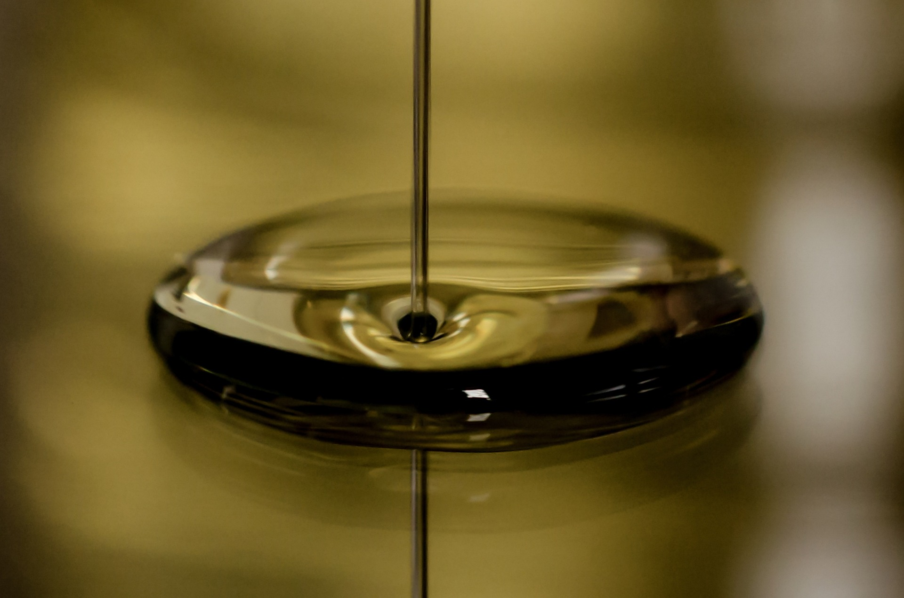
"Data is the New Oil" [1] Clive Humby, Mathematician, 2006
C: Rudy and Peter Skitterians / Pixabay [2]
Master Automation & IT – Object Oriented Programming – Graphical User Interface
Yuganshu Wadhwa, Allan Thomas Aldo, Niels Schwung
03/20/2023
Notes:
Quote by Clive Humby, Mathematician, 2006

Slide 3
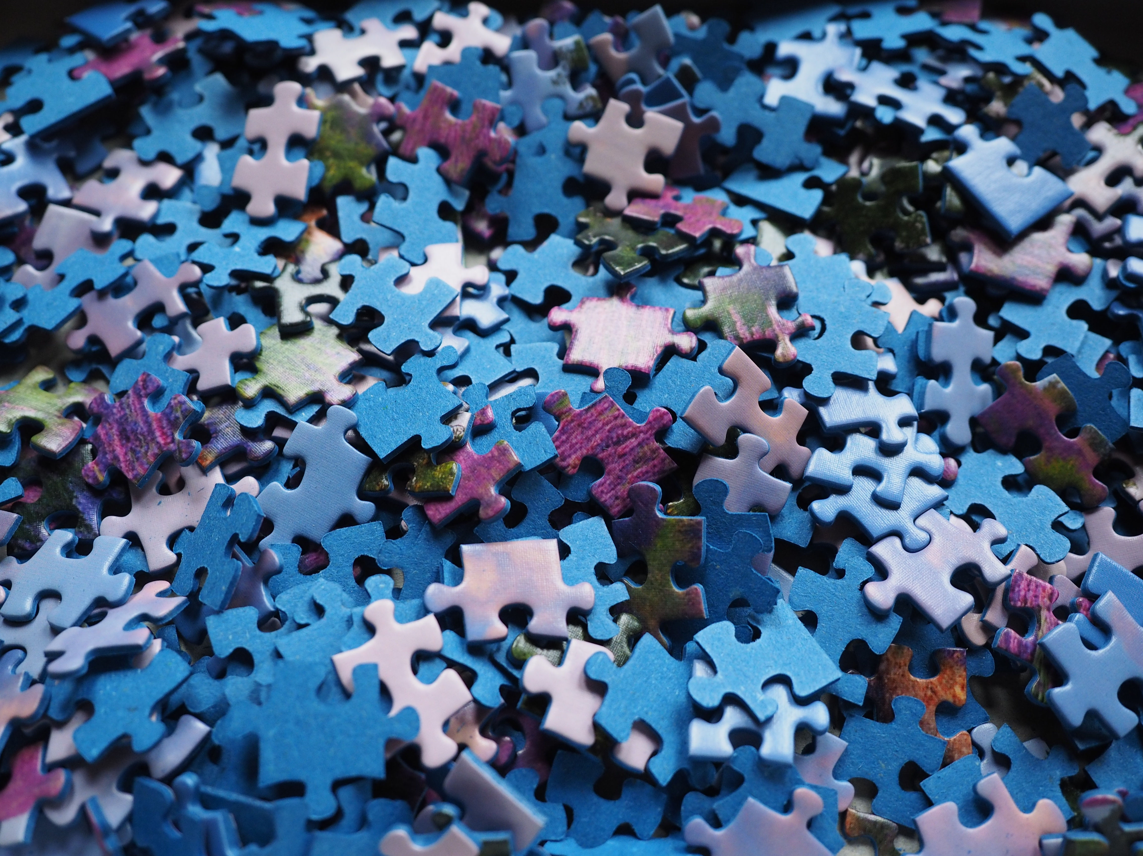
Data is a Big Puzzle
C: Hans / Pixabay [3]
Master Automation & IT – Object Oriented Programming – Graphical User Interface
Yuganshu Wadhwa, Allan Thomas Aldo, Niels Schwung
03/20/2023
Notes:
Quote by Clive Humby, Mathematician, 2006

Slide 4
Get the Oil out of the Puzzle
[3]​
[2]​
Master Automation & IT – Object Oriented Programming – Graphical User Interface
Yuganshu Wadhwa, Allan Thomas Aldo, Niels Schwung
03/20/2023

Slide 5
Valuable Information!
Master Automation & IT – Object Oriented Programming – Graphical User Interface
Yuganshu Wadhwa, Allan Thomas Aldo, Niels Schwung
03/20/2023

Slide 6
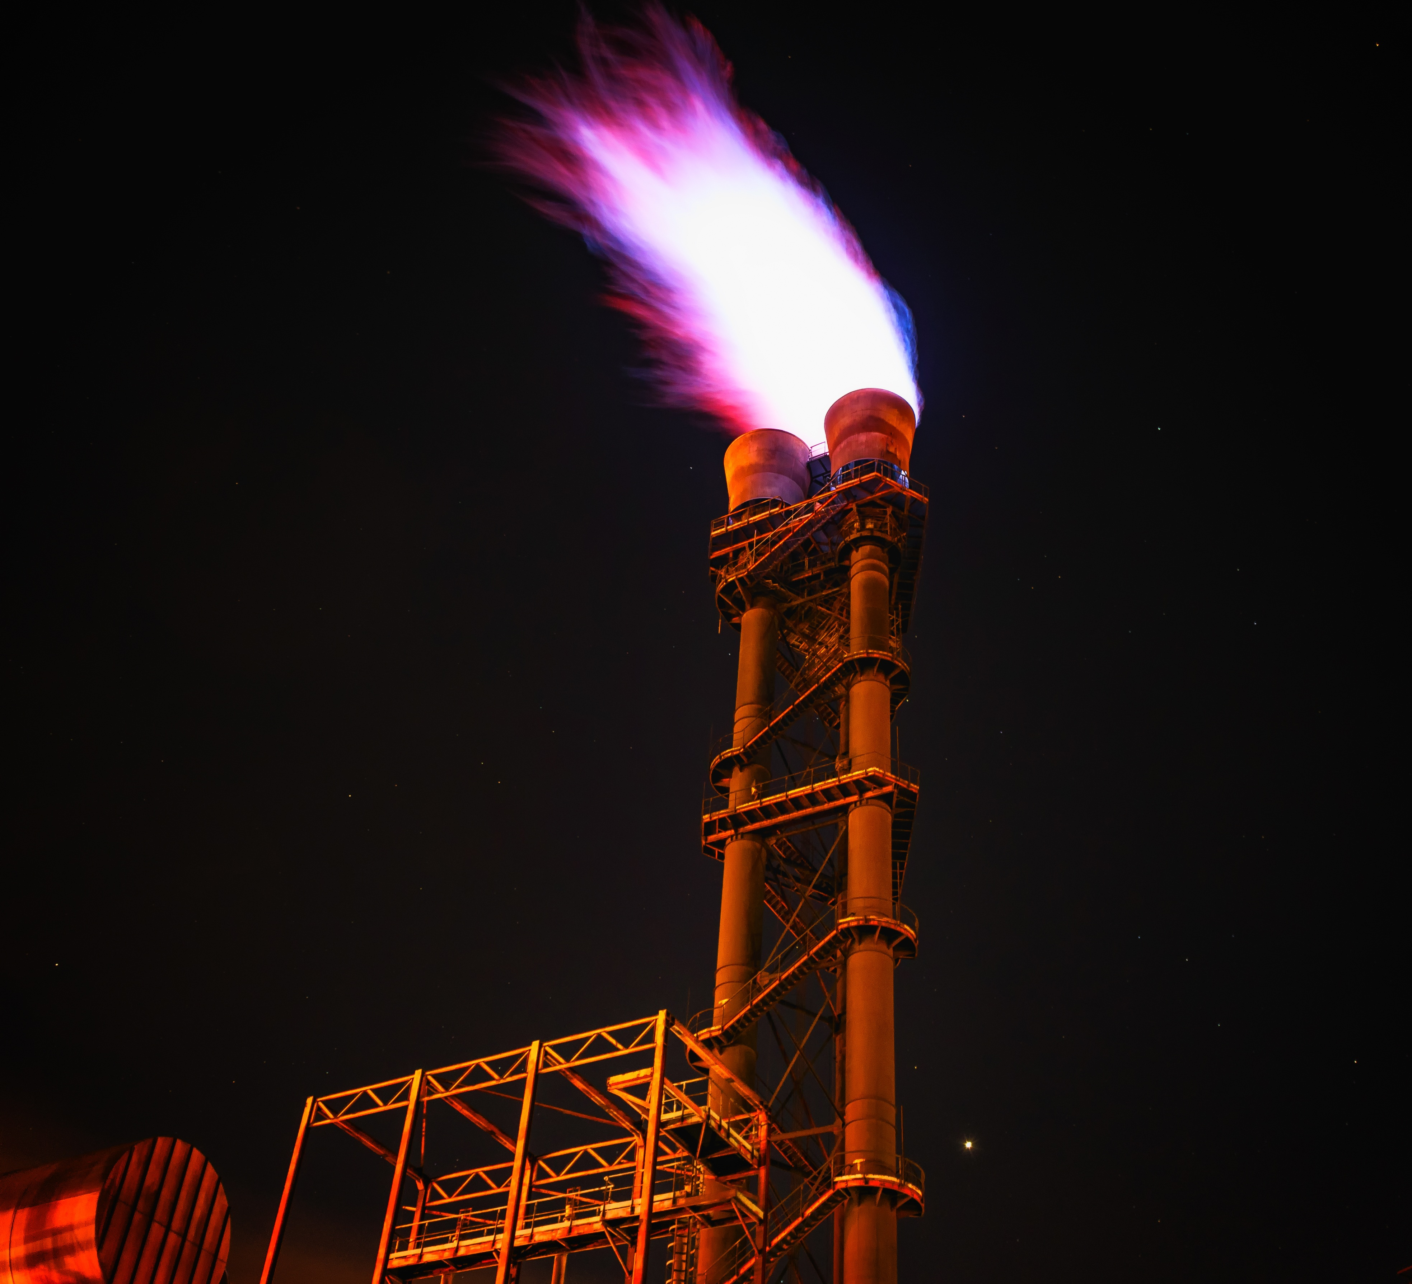
Agenda
The Rough Data
The Backbone
The Classes
The Pages
Code Demo
C: Peter H / Pixabay [4]
Master Automation & IT – Object Oriented Programming – Graphical User Interface
Yuganshu Wadhwa, Allan Thomas Aldo, Niels Schwung
03/20/2023

Slide 7
The Rough Data
C: Hans / Pixabay [3]
Master Automation & IT – Object Oriented Programming – Graphical User Interface
Yuganshu Wadhwa, Allan Thomas Aldo, Niels Schwung
03/20/2023

Slide 8
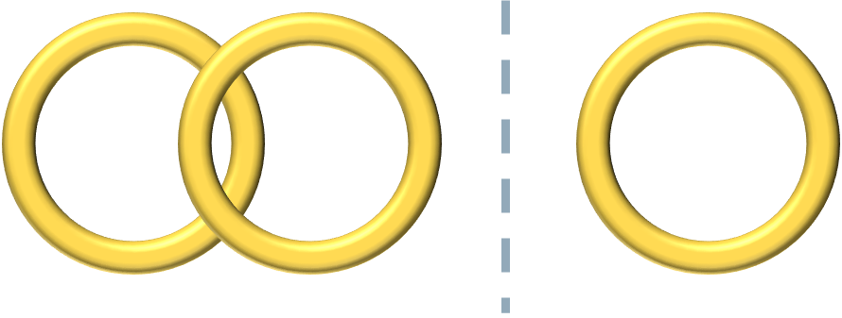
Couples Dataset [9]
Questions:
1.
…
…
…
...
50.
0
1
2
3
4
Totally Disagree
Totally Agree
Divorced
Predict
Married
Master Automation & IT – Object Oriented Programming – Graphical User Interface
Yuganshu Wadhwa, Allan Thomas Aldo, Niels Schwung
03/20/2023

Slide 9
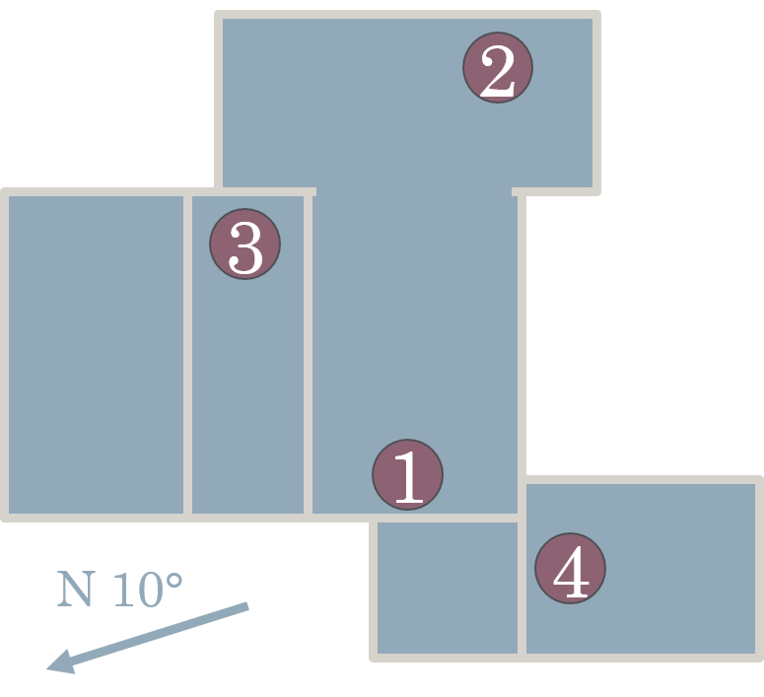
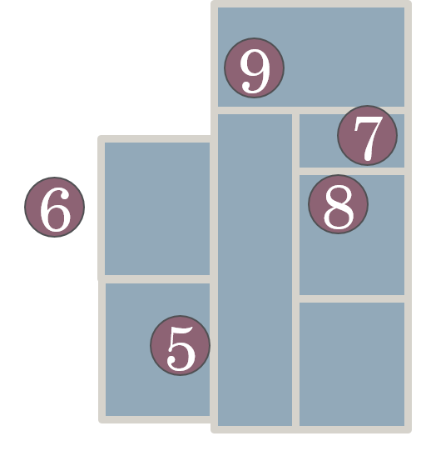
Energy Dataset [10]
Sensor:
Temperature
Humidity
Nearby Weather Data
Energy
t
Master Automation & IT – Object Oriented Programming – Graphical User Interface
Yuganshu Wadhwa, Allan Thomas Aldo, Niels Schwung
03/20/2023

Slide 10
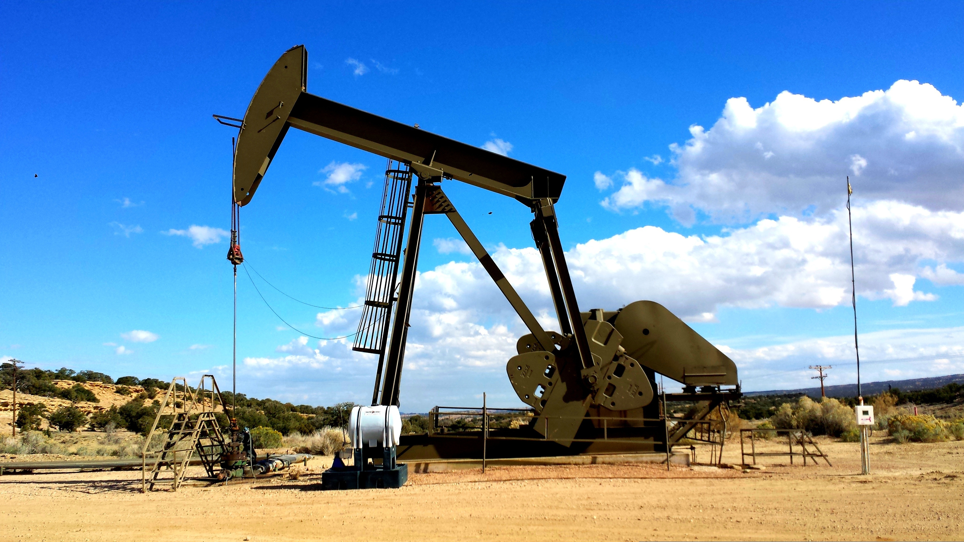
The Backbone
C: John R Perry / Pixabay [5]
Master Automation & IT – Object Oriented Programming – Graphical User Interface
Yuganshu Wadhwa, Allan Thomas Aldo, Niels Schwung
03/20/2023

Slide 11

The Backbone, Streamlit
What is Streamlit ?
Streamlit is a Python library used for building interactive applications quickly and easily.
The following are a few use scenarios for Streamlit
Machine learning model development
Creating user interfaces
Education and training
Prototyping and experimenting
Master Automation & IT – Object Oriented Programming – Graphical User Interface
Yuganshu Wadhwa, Allan Thomas Aldo, Niels Schwung
03/20/2023
Notes:
It simplifies the web application development process by providing pre-built widgets and components that allow users to create interactive data visualizations, input forms, and other UI elements with just a few lines of code. Streamlit is ideal for creating data science and machine learning applications, where data needs to be visualized and analyzed in an interactive way.
1.Streamlit makes it easy to build interactive data visualizations and dashboards, allowing users to explore and analyze large datasets in real-time.
2.Streamlit can be used to build user interfaces for machine learning models, making it easier to test and fine-tune models and present results to stakeholders.
3.Streamlit can be used for teaching and training purposes, allowing users to build interactive tutorials, exercises, and simulations.
4.Streamlit's ease of use and rapid development capabilities make it ideal for quickly prototyping and experimenting with new ideas and projects.

Slide 12


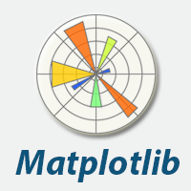



Important Libraries
Streamlit
NumPy
pandas
matplotlib and seaborn
scikit-learn
TensorFlow
Master Automation & IT – Object Oriented Programming – Graphical User Interface
Yuganshu Wadhwa, Allan Thomas Aldo, Niels Schwung
03/20/2023
Notes:
Streamlit : Infrastructure of GUI and its related elements
NumPy : Fundamental package for scientific computing
pandas : Used for manipulation and analysis of dataframes
matplotlib and seaborn : Basic libraries used to create graphical outputs
scikit-learn : Library used to implement machine learning, and related methods
TensorFlow : Used for AI based models and methods

Slide 13
General Layout
GUI Class
Application as Collection of Pages
Data Files
General and Feature Pages
Classes from other groups
Trigger:
Streamlit run "About The Application.py"
Master Automation & IT – Object Oriented Programming – Graphical User Interface
Yuganshu Wadhwa, Allan Thomas Aldo, Niels Schwung
03/20/2023

Slide 14
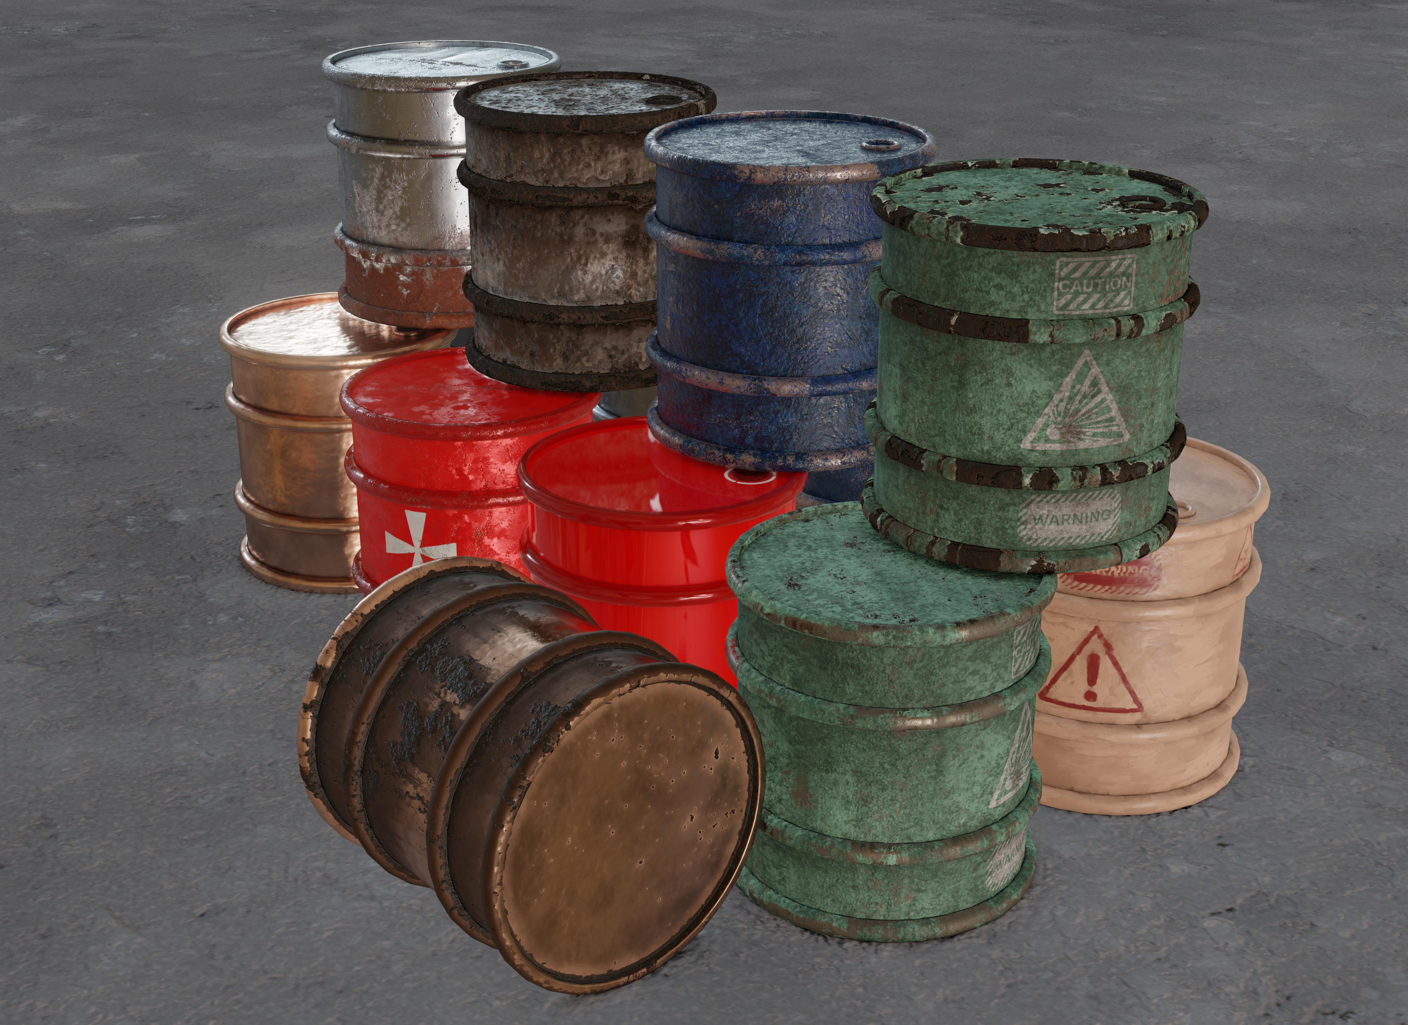
The Classes
R: Arthur Ziiim / Pixabay [6]
Master Automation & IT – Object Oriented Programming – Graphical User Interface
Yuganshu Wadhwa, Allan Thomas Aldo, Niels Schwung
03/20/2023

Slide 15
Flow of Information
User Input
GUI and Data Class
Classes from Other Groups
Data Class (Intermediate Classes)
Classes from the other groups call methods from data classes and display results
Master Automation & IT – Object Oriented Programming – Graphical User Interface
Yuganshu Wadhwa, Allan Thomas Aldo, Niels Schwung
03/20/2023

Slide 16
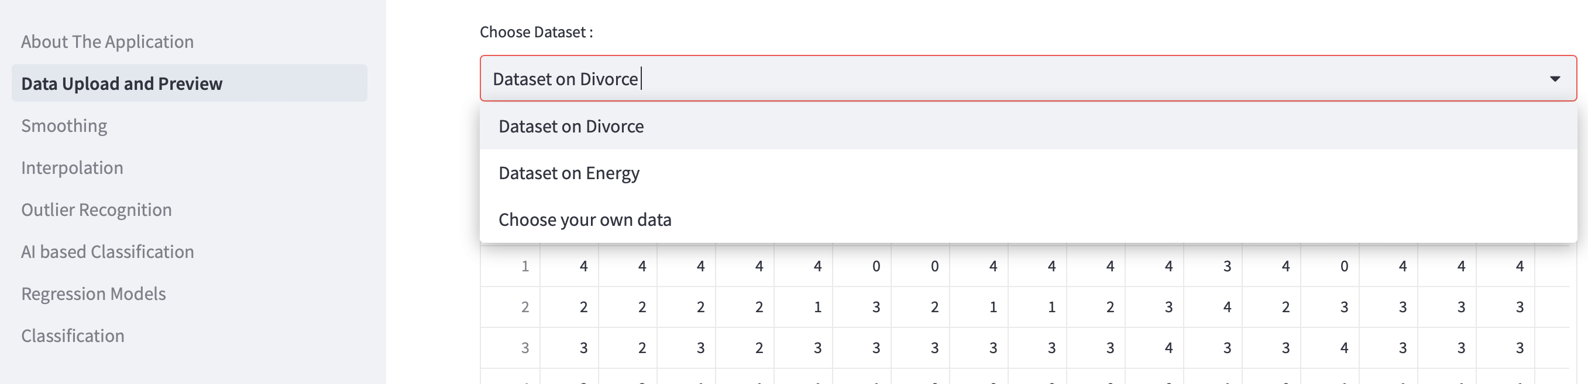
Primary Class for GUI Implementation
 | '''
 | arg_df
 | arg_filename
 | '''
 | def __init__(self, arg_df, arg_filename='') :
Master Automation & IT – Object Oriented Programming – Graphical User Interface
Yuganshu Wadhwa, Allan Thomas Aldo, Niels Schwung
03/20/2023

Slide 17
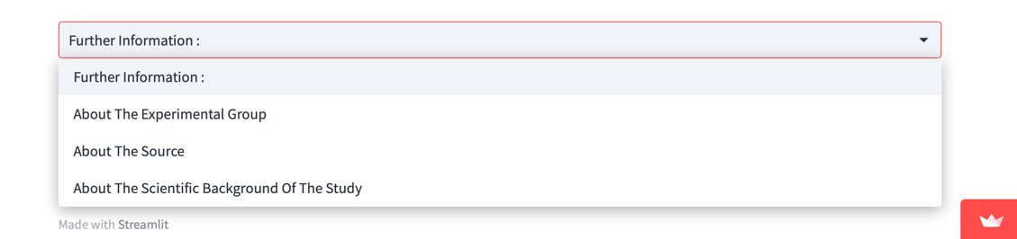
Primary Class GUI Implementation
if choice == 'About The Experimental Group' :
st.markdown("""
Master Automation & IT – Object Oriented Programming – Graphical User Interface
Yuganshu Wadhwa, Allan Thomas Aldo, Niels Schwung
03/20/2023

Slide 18
Dataclasses (Classes used to exchange Information)
CLASS GUI_CHILD_SMOOTHING(GUI_CLASS) :
'''
def __init__ (self, arg_df, arg_filename, x_axis, x_axis_start, x_axis_end, y_axis, window_size = 5, poly_degree = 2, alpha = 0) :
GUI_class.__init__(self, arg_df, arg_filename)
self.x_axis = x_axis
self.x_axis_start = x_axis_start
self.x_axis_end = x_axis_end
self.y_axis = y_axis
self.window_size = window_size
self.poly_degree = poly_degree
self.alpha = alpha
Master Automation & IT – Object Oriented Programming – Graphical User Interface
Yuganshu Wadhwa, Allan Thomas Aldo, Niels Schwung
03/20/2023

Slide 19

APPLICATION
PAGES

Slide 20
Pages : Containers and Textual Information
header_cont = st.container()
inputs_cont = st.container()
result_cont = st.container()
with header_cont :
st.markdown("<h2 style = 'text-align : center; color : #0077b6;'> DATA SMOOTHING </h2>", unsafe_allow_html = True)
st.markdown("<div style ='text-align: justify;'> <b>Smoothing is applied to reduce the effect of high-frequency noise and bring out key aspects of the signal, ...
Master Automation & IT – Object Oriented Programming – Graphical User Interface
Yuganshu Wadhwa, Allan Thomas Aldo, Niels Schwung
03/20/2023

Slide 21
Pages : User Inputs
with inputs_cont :
choice_text, choice_box = st.columns([1, 2])
choice_text.markdown('Select Method to Smoothen the Data :')
method = choice_box.selectbox(label = '', label_visibility =
'collapsed', options = ['Savitzky-Golay', 'Moving Average',
'Exponential'], index = 0)
if method == 'Savitzky-Golay' :
st.markdown("<h4 style = 'text-align : left; color : #0096c7;'>
Savitzky-Golay Filter </h4>", unsafe_allow_html = True)
st.markdown("<div style ='text-align: justify;'> The Savitzky-
Golay smoothing filter works by fitting a polynomial ... \
Master Automation & IT – Object Oriented Programming – Graphical User Interface
Yuganshu Wadhwa, Allan Thomas Aldo, Niels Schwung
03/20/2023

Slide 22
Pages : User Inputs, Loading Data from Cache
df_original = st.session_state['GUI_data'].data
interpolated_df = st.session_state['interpolated_df']
y_axis = st.selectbox(label = 'Select Column to use as Y-Axis :',
options = y_options, index = 0)
x_axis_range = st.select_slider(label = 'Select Range for X-Axis :',
options = sorted(working_df[x_axis].unique()),
value = (sorted(working_df[x_axis])[0],
sorted(working_df[x_axis])[-1]))
st.markdown("Selected Range : &nbsp;&nbsp; *from &nbsp; **%s** &nbsp;
to &nbsp; **%s***" % (str(x_axis_range[0]), str(x_axis_range[1])))
x_axis_start = x_axis_range[0]
x_axis_end = x_axis_range[1]00
Master Automation & IT – Object Oriented Programming – Graphical User Interface
Yuganshu Wadhwa, Allan Thomas Aldo, Niels Schwung
03/20/2023

Slide 23
Pages : Initialize Objects, Call Methods
GUI_smoothing_data = GUI_child_Smoothing(working_df, GUI_data.filename,
x_axis, x_axis_start, x_axis_end, y_axis, window_size, poly_degree)
Smoothing_data = Smoothing_class(GUI_smoothing_data)
Smoothing_data.savgol_filter()
Master Automation & IT – Object Oriented Programming – Graphical User Interface
Yuganshu Wadhwa, Allan Thomas Aldo, Niels Schwung
03/20/2023

Slide 24
Pages : Displaying Results
with result_cont :
st.markdown("<h5 style = 'text-align : left; color : #0096c7;'>
Results : </h5>", unsafe_allow_html = True)
st.pyplot(Smoothing_data.fig)
Master Automation & IT – Object Oriented Programming – Graphical User Interface
Yuganshu Wadhwa, Allan Thomas Aldo, Niels Schwung
03/20/2023

Slide 25
Pages : Storing Data in Cache, Download Widget
st.session_state['smoothed_df'] = smoothed_df
st.download_button(label = 'Download Smoothed Data',
file_name = 'Smoothed_Data.csv',
data = smoothed_df.to_csv(),
mime = 'text/csv')
Master Automation & IT – Object Oriented Programming – Graphical User Interface
Yuganshu Wadhwa, Allan Thomas Aldo, Niels Schwung
03/20/2023

Slide 26
Code Demo …
Master Automation & IT – Object Oriented Programming – Graphical User Interface
Yuganshu Wadhwa, Allan Thomas Aldo, Niels Schwung
03/20/2023
Notes:
Quote by Clive Humby, Mathematician, 2006

Slide 27
Summary
R: Engin Akyurt / Pixabay [8]
Master Automation & IT – Object Oriented Programming – Graphical User Interface
Yuganshu Wadhwa, Allan Thomas Aldo, Niels Schwung
03/20/2023
Notes:
Quote by Clive Humby, Mathematician, 2006

Slide 28

Data is the New Oil …
… and Information is the Energy you get from it
R: Joe jplenio / Pixabay [11]
Master Automation & IT – Object Oriented Programming – Graphical User Interface
Yuganshu Wadhwa, Allan Thomas Aldo, Niels Schwung
03/20/2023

Slide 29
References
[1]: Clive Humby, 2006, published by Samuel Flender, 2019, in TowardsDataScience, Data is not the new oil. About the reality of working with data | by Samuel Flender | Towards Data Science
[2]: Rudy and Peter Skitterians / Pixabay, 2015, Öl Benzin Automobil - Kostenloses Foto auf Pixabay
[3] Hans / Pixabay, 2015, Puzzleteile Puzzle Spiel - Kostenloses Foto auf Pixabay
[4] Peter H, Tama66 / Pixabay, 2017, Feuer Flamme Fackel - Kostenloses Foto auf Pixabay
[5] John R Perry, jp26jp / Pixabay, 2014, Raffinerie Pumpe Ölpumpe - Kostenloses Foto auf Pixabay
[6] Arthur Ziiim / Pixabay, 2021, Fässer Rost Öl - Kostenloses Foto auf Pixabay
[7] motointermedia / Pixabay, 2016, Diesel Tankuhr Tankstelle - Kostenloses Foto auf Pixabay
[8] Engin Akyurt / Pixabay, 2022, Treibstoff Tankstelle Tanken - Kostenloses Foto auf Pixabay
[9] Dr. Ögr. Üyesi Mustafa Kemal Yöntem, Dr. Ögr. Üyesi Kemal Adem, Prof. Dr. Tahsin Ilhan, Ögr. Gör. Serhat Kilicarslan, "Divorce Prediction using Correlation based Feature Selection and Artificial Neural Networks", E-ISSN: 2149-3871, 2019, Nevsehir Haci Bektas Veli University, SBE Dergisi, Turkey, Introduced at International Congress on Politics, Economics and Social Studies, 2018
[10] Luis M. Candanedo, Véronique Feldheim, Dominique Deramaix, "Data driven prediction models of energy use of appliances in a low-energy house", Thermal Engineering and Combustion Laboratory, University of Mons, Belgium, Published in "Energy and Buildings", season 140 (2017), Pp. 81-97
[11] Joe, jplenio / Pixabay, 2018, Natur Landschaft Himmel - Kostenloses Foto auf Pixabay
Master Automation & IT – Object Oriented Programming – Graphical User Interface
Yuganshu Wadhwa, Allan Thomas Aldo, Niels Schwung
03/20/2023

